Slide 1
Meliadine Project – Overview Saline Effluent Discharge to Marine Environment ᑕᓯᕐᔪᐊᕐᒥᑦ ᐱᓕᕆᐊᑦ - ᐱᔾᔪᑎᖃᖅᑐᖅ ᑕᕆᐅᓕᖕᒥᑦ ᑯᕕᔪᖅ ᑯᕕᑎᑕᐅᔪᖅ ᑕᕆᐅᕐᒧᑦ
Final Hearing: June 14-17
ᑭᖑᓪᓕᖅᐹᒃᑯᑦ ᑲᑎᒪᑎᑦᑎᓂᖅ: ᒪᓐᓃᑦ 14-17

Slide 2
Presentation Overview
ᑕᑯᕋᓐᓈᒐᕐᒥᑦ ᐱᔾᔪᑎᖃᖅᑐᖅ
Project Overview
Introduction
3D rendering video
Description of project components
Public Participation and Engagement
Response to Final Written Submissions + Commitments Made
ᕿᒥᕐᕈᓂᖅ ᐱᓕᕆᐊᒥᑦ
ᓇᓗᓇᐃᔭᐃᓂᖅ
ᑕᒡᕙᓪᓗᐊᕕᐅᔮᖅᖢᒍ ᑕᕆᔭᐅᑎ
ᖃᓄᐃᑦᑑᓂᖏᑦ ᐱᓕᕆᐊᕐᒧᑦ ᐃᓚᒋᔭᐅᔪᑦ
ᐃᓄᓗᒃᑖᓂᒃ ᐃᓚᐅᓂᖏᑦ ᐊᒻᒪᓗ ᐃᓚᐅᑎᑦᑎᓂᖅ
ᑭᐅᔾᔪᑏᑦ ᑭᖑᓪᓕᖅᐹᑦ ᑎᑎᕋᖅᓯᒪᔪᑦ ᑐᓂᔭᐅᔪᓄᑦ ᐊᒻᒪᓗ ᐱᓂᐊᕐᓂᕆᔭᐅᔪᓕᐅᕐᓃᑦ
Notes:
Specific topics we will review in this presentation include:
Project design and rationale
A short 3-dimensional rendering video of the waterline
Description of the project components in the
Construction, operations, and removal/reclamation phases
Public engagement

Slide 3
Project Overview
ᕿᒥᕐᕈᓂᖅ ᐱᓕᕆᐊᒥᑦ
3

Slide 4
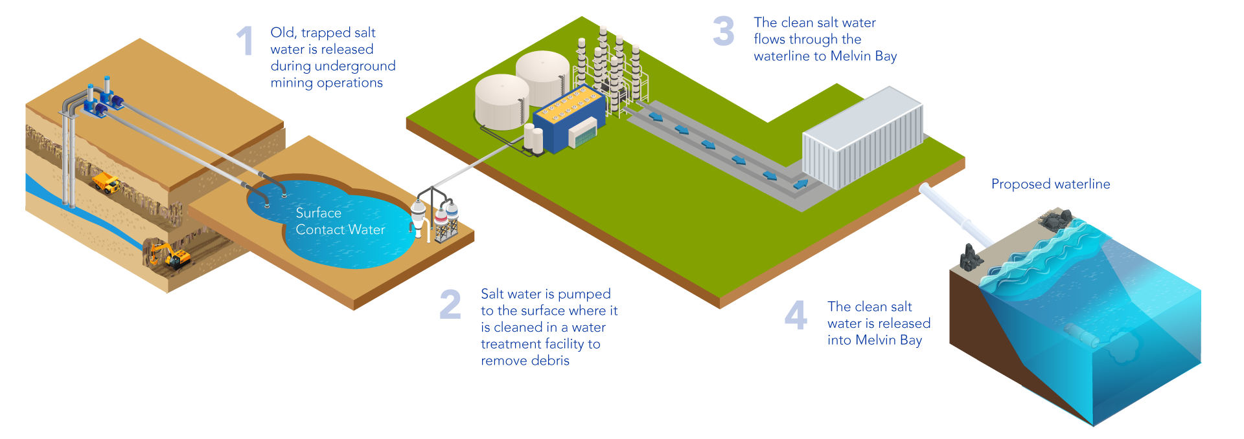
Waterline Project
ᓱᑉᓗᓕᖕᒧᑦ ᐱᓕᕆᐊᖅ
The waterline project is an amendment to the Meliadine project approved in 2018
A 34-kilometer waterline from Meliadine to Itivia is proposed
2 x 16-inch-high density polyethylene (HDPE, a type of plastic) lines
The amount of water being released into Melvin Bay would increase from 800 – 1,600 m³ per day to 6,000 - 12,000 m³ per day (around 1.6 - 3.2 million US gallons per day), and the alternative up to 20,000 m³ per day
ᓱᑉᓗᓕᖕᒧᑦ ᐱᓕᕆᐊᖅ ᐋᖅᑭᒋᐊᖅᓯᓂᐅᔪᖅ ᑕᓯᕐᔪᐊᕐᒥᑦ ᐱᓕᕆᐊᕐᒧᑦ ᓈᒻᒪᒋᔭᐅᓚᐅᖅᑐᖅ 2018-ᒥᑦ.
34-ᓂᒃ ᑭᓛᒥᑕᓂᒃ ᑕᑭᑎᒋᔪᖅ ᓱᑉᓗᓕᒃ ᑕᓯᕐᔪᐊᕐᒥᙶᖅᑐᖅ ᐃᑎᕕᐊᓄᙵᐅᔪᖅ ᑐᒃᓯᕋᐅᑕᐅᔪᖅ.
2 x 16 ᐃᓐᓯᓂᒃ ᖁᑦᑎᖕᓂᓕᒃ ᓴᙱᔪᖅ ᐊᐅᒃᑕᔫᕐᒥᑦ ᓱᑉᓗᓖᑦ
ᐃᒪᖅ ᑯᕕᑎᑕᐅᔪᖅ ᐃᑎᕕᐊᓄᑦ ᐊᖏᒡᓕᒋᐊᕋᔭᖅᑐᖅ 800 – 1,600 m3 ᖃᐅᑕᒫᑦ 6,000 - 12,000 m3 ᖃᐅᑕᒫᒧᑦ (1.6 - 3.2 ᒥᓕᔭᓐ ᒑᓚᓐᓗᐊᒃᑦ ᐅᑉᓗᑕᒫᑦ), ᐊᒻᒪᓗ ᐊᓯᐊᒍᖔᖅ ᑎᑭᓪᓗᒍ 20,000 m3 ᖃᐅᑕᒫᑦ
Notes:
The proposed waterline project is an extension of the saline diffuser project that was approved in 2019 –
That project was for trucking of saline water to the coast and discharge through a seasonally temporary diffuser
The waterline project has been presented to the community through various consultation events
The design has been adjusted based on feedback we received during those sessions.
The figures on this slide illustrate
As underground mining progress, groundwater (old seawater) seeps into the mine workings
This water is pumped out of the mine and to storage ponds/pits at surface
The water is pumped for treatment and then discharged to the ocean
The main scope of this current project – or the waterline project - is to change the way we transport this saline water from the mine to the ocean:
Through this project, treated saline will water will be moved through a waterline rather than through multiple trucks
Like the current approved method, the discharge will occur during open-water conditions
There will be further discussion on this slide during the marine environment presentation

Slide 5
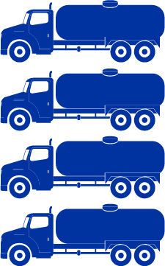
Waterline Project / ᓱᑉᓗᓕᖕᒧᑦ ᐱᓕᕆᐊᖅ
Trucks required per day to transport increased amount of water
150 to 300 trucks per day
Without a waterline, traffic on the road will increase to 150-300 trucks a day from the current 20 to 40 trucks
A waterline is better for the environment and safety than adding more trucks on the road
ᓱᑉᓗᓕᖃᙱᓪᓗᓂ, ᐃᖏᕐᕋᔭᒃᑐᑦ ᐊᑉᖁᑎᒥᑦ ᐊᒥᓱᙳᕆᐊᕋᔭᖅᑐᑦ 150-300-ᓄᑦ ᓄᓇᒃᑰᕈᑏᑦ ᖃᐅᑕᒫᒃᑯᑦ 20-ᓂᒃ 40-ᓄᑦ ᓄᓇᒃᑰᕈᑎᓂᑦ
ᓱᑉᓗᓕᒃ ᐱᐅᓂᖅᓴᐅᔪᖅ ᐊᕙᑎᒧᑦ ᐊᒻᒪᓗ ᐅᓗᕆᐊᓇᖅᑐᖃᙱᑎᑦᑎᓂᕐᒧᑦ ᐊᒥᓱᙳᕆᐊᕐᓗᒋᐅᖓᓂᑦ ᐊᑉᖁᑎᒦᓐᓂᐊᖅᑐᑦ ᓄᓇᒃᑰᕈᑏᑦ
Trucks required per day to transport current approved amount of water
20 to 40 trucks per day
x10
20-ᓂᒃ 40-ᓄᑦ ᓄᓇᒃᑰᕈᑏᑦ ᖃᐅᑕᓄᓇᒃᑰᕈᑏᑦ ᐊᑐᖅᑕᐅᔭᕆᐊᖃᖅᑐᑦ ᖃᐅᑕᒫᒃᑯᑦ ᒫᓐᓇ ᓈᒻᒪᒋᔭᐅᔪᖅ ᐊᒡᔭᖅᑕᐅᓂᐊᕐᓗᓂ ᐃᒪᖅ
ᓄᓇᒃᑰᕈᑏᑦ ᐊᑐᖅᑕᐅᔭᕆᐊᖃᖅᑐᑦ ᖃᐅᑕᒫᒃᑯᑦ ᐊᒡᔭᖅᑕᐅᓂᐊᕐᓗᓂ ᐃᒪᖅ
150-300 ᓄᓇᒃᑰᕈᑏᑦ ᖃᐅᑕᒫᒃᑯᑦ
Notes:
When mine development began at Meliadine, we knew there would be inflows of groundwater (the same as old seawater) to the underground workings
As we continue mine development at Meliadine, more groundwater will move into those underground workings
This water will need to captured, stored, treated and then discharged
Under the approved project, we use 20 to 40 trucks per day to transport the groundwater to the ocean for discharge
The discharge occurs by a diffuser at Melvin Bay that needs to be installed and removed every year
We are predicting that future quantities of groundwater will increase
Based on those predictions, we would need 150 to 300 trucks per day to transport the groundwater to the ocean for discharge
Or – we could build a waterline
The benefits of this solution include:
Less truck traffic on the road – less dust, less noise
Less water discharged to Meliadine Lake because some of that water could be discharged through the waterline instead

Slide 6
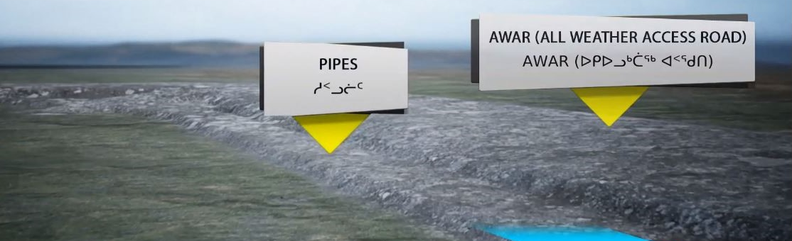
ᑕᒡᕙᓪᓗᐊᕕᐅᔮᖅᖢᒍ ᑕᕆᔭᐅᑎ
3D Rendering
Notes:
Play the video
There is no sound with this video, so I will just speak to a few of the features
This video has been prepared to provide graphic representation of the proposed waterline
We will start at the mine and end at Melvin Bay
Starting at the underground ramp we see a pipe coming out of the underground
This pipe is moving water collected in the underground workings to a saline storage pond
From this pond, water is treated
Exiting from the treatment plant are two lines carrying treated water
These lines are directed towards the all weather access road
From here the waterline runs parallel to the road
This next detail shows the tundra, a step-up to the covered waterlines, and a step-up to the road
A little further down we have an example of a land user crossing
Moving to the watercourse crossings
Example of the waterline above the culvert crossing and outside of the channel
And over to a bridge – showing how the waterline will be connected to the bridge and again outside of the channel
Moving to Melvin Bay – the structure illustrates how the two lines will come together into the final discharge pipe
The pipe will be installed through the bedrock and into the bay below the low tide zone
The final segment here shows the pipe along the marine bed and ending in a diffuser – at a depth of approximately 20 to 24 m of water
the diffuser is used to enhance mixing

Slide 7
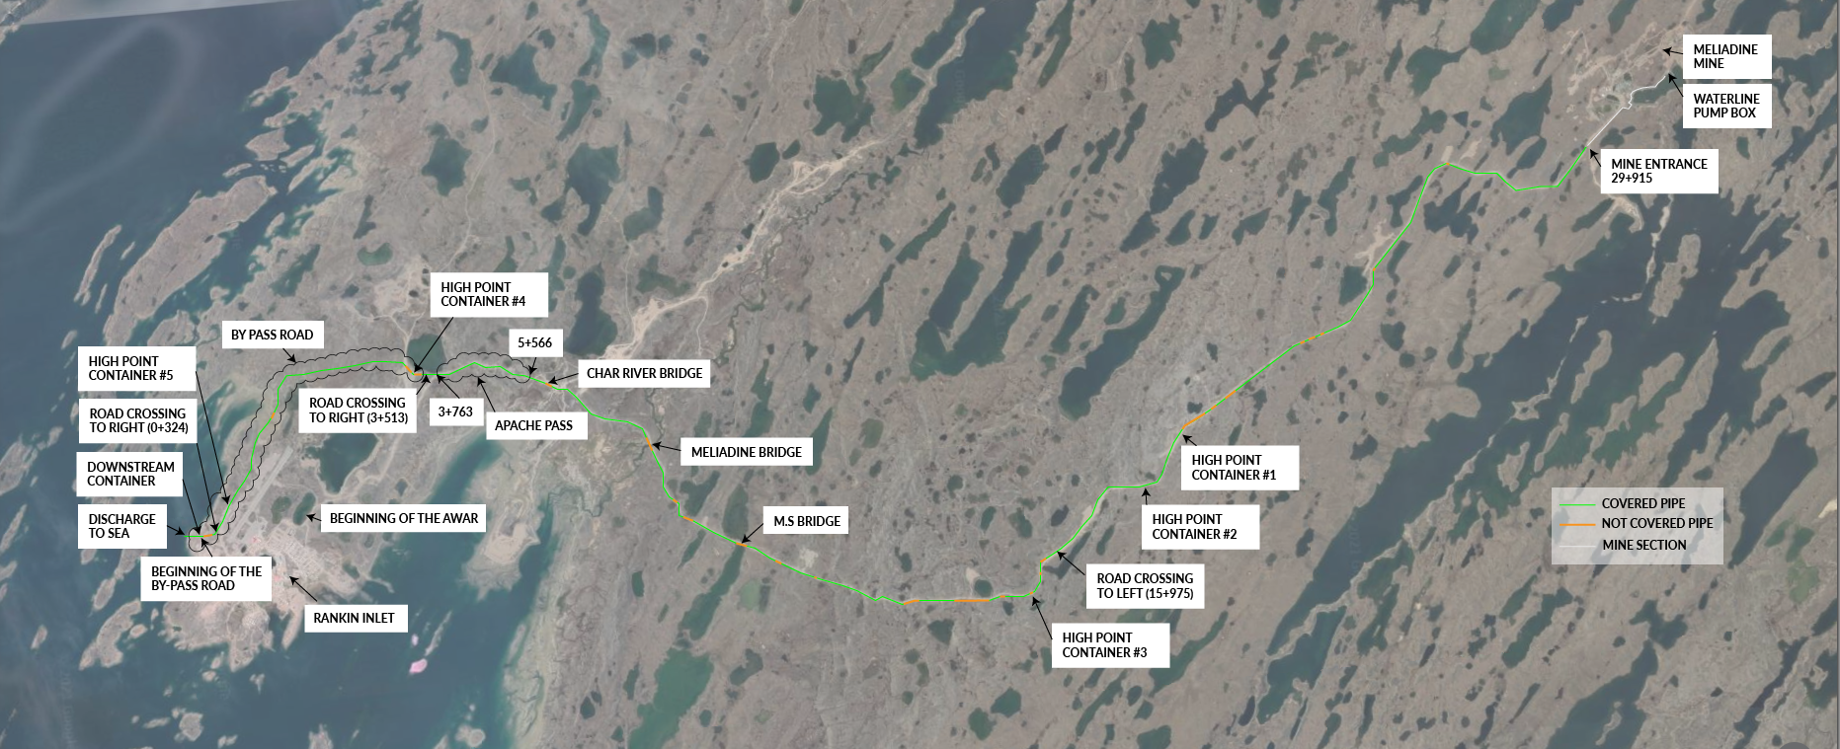
CONSTRUCTION / ᓴᓇᔪᑦ
Notes:
This slide shows the alignment of the waterline from the Mine (upper right corner) to Melvin Bay (lower left corner)
Adjustments to this plan have been informed and adjusted based on inputs received through community consultation
For example
In the area of Apache Pass the waterlines will be routed on the East side of the rock outcrop
the original plan included an uncovered or exposed waterline
Community members were concerned with the ability for caribou to safely cross the waterline
The first design update included adding numerous wildlife crossings
Through further consultation, it was suggested that the waterline should be covered
Based on the feedback we adjusted the design, and now approximately 80 to 90% of the waterline will be covered

Slide 8
CONSTRUCTION / ᓴᓇᔪᑦ
Notes:
These images illustrate the placement of the waterline relative to the road
These images also show two waterlines
The original design included one large waterline
Through consultation, the community identified that a single line may impact caribou movement, or that it might not be safe for snowmobilers and ATV riders to cross
Based on this consultation, the design has been updated to include two smaller, and parallel lines
As noted on the previous slide, 80 to 90% of the waterline will be covered
The top left image shows the general placement and cover design for most of the covered portion of the waterline
Sections where the waterline will not be covered include
rock cuts and rocky ground where a cover could damage the waterline, and
watercourse crossings
The bottom images illustrate the general placement for uncovered portions of the waterline

Slide 9
CONSTRUCTION / ᓴᓇᔪᑦ
The waterline will run adjacent to the approved All-Weather Access Road
The waterline will be covered with esker material to allow caribou to cross easily
Construction will be timed outside of the migration season
ᓱᑉᓗᓕᒃ ᓴᓂᐊᓃᓐᓂᐊᖅᑐᖅ ᓈᒻᒪᒋᔭᐅᔪᖅ ᐅᑭᐅᓗᒃᑖᖅ ᐊᑉᖁᑎᐅᑉ
ᓱᑉᓗᓕᒃ ᖄᓕᖅᓯᒪᓂᐊᖅᑐᖅ ᓄᓇᒥᑦ ᐱᔭᐅᔪᒥᒃ ᑐᒃᑐᐃᑦ ᐃᑳᕐᕕᒋᔪᖕᓇᕐᓂᐊᕐᓗᓂᐅᒃ
ᓴᓇᔭᐅᕙᓪᓕᐊᓂᖓ ᖃᐅᔨᓴᖅᑕᐅᓂᐊᖅᑐᖅ ᖃᓄᑎᒋᐅᓂᖓᓄᑦ ᓯᓚᑖᓂᑦ ᑐᒃᑐᐃᑦ ᐊᒥᕐᕋᐃᑦ ᑎᑭᖃᑦᑕᖅᑎᓪᓗᒋᑦ
All Weather Access Road
ᐅᑭᐅᓗᒃᑖᖅ ᐊᑉᖁᑎ
Notes:
The waterline will run adjacent to the approved All-Weather Access Road
There will be a step down from the road surface to the covered waterline surface, and then a second step down to the tundra
The waterline will be covered with esker material, which is a firm substrate to allow caribou, and ATVs to easily cross
Construction will be timed outside of the migration season – Agnico Eagle made a commitment (Commitment 9) to no open trenches during caribou migration
There will be further discussion on this slide during the terrestrial wildlife presentation

Slide 10
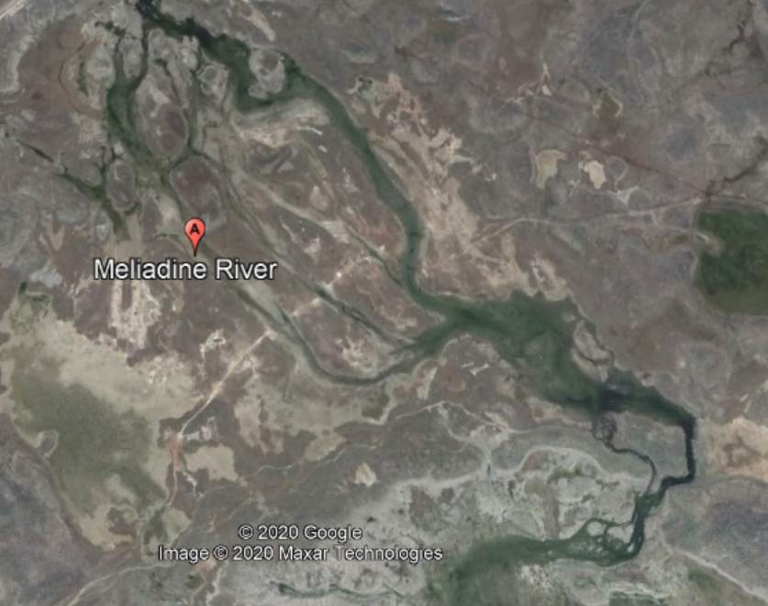
CONSTRUCTION / ᓴᓇᔪᑦ
Waterline will be carefully positioned to allow for unobstructed flows during spring freshet conditions
The waterline will run directly under, and secured to bridges, avoiding any potential disturbance to habitat below the high watermark
Heavy machinery will not be used within the high watermark during installation
ᓱᑉᓗᓕᒃ ᐅᔾᔨᖅᑐᖅᑕᐅᓗᓂ ᐃᓕᔭᐅᓂᐊᖅᑐᖅ ᓯᒥᒃᑕᐅᓂᐊᖏᓪᓗᑎᒃ ᑯᕕᔪᑦ ᐅᐱᕐᖔᒃᑯᑦ ᐊᐅᒃᐸᓪᓕᐊᑎᓪᓗᒍ
ᓱᑉᓗᓕᒃ ᐊᑖᓃᓐᓂᐊᖅᑐᖅ, ᐊᒻᒪᓗ ᐃᓕᔭᐅᓯᒪᑦᑎᐊᕐᓗᑎᒃ ᐃᑳᕈᑎᓂᑦ, ᐃᖢᐃᓵᕆᓂᖃᕐᓂᐊᖏᓪᓗᑎᒃ ᐃᓂᒋᔭᐅᔪᓂᑦ ᐊᑖᓃᑦᑐᓂᑦ ᖁᑦᑎᖕᓂᖅᐹᑉ ᐃᒪᕐᒥᑦ
ᐃᑯᒪᓅᖅᑐᑦ ᐊᑐᖅᑕᐅᔾᔮᙱᑦᑐᑦ ᖁᑦᑎᖕᓂᖅᐹᖅ ᐃᒪᖃᕐᓂᕐᒥᑦ ᐃᓕᐅᖅᑲᖅᑕᐅᑎᓪᓗᒋᑦ
Notes:
The waterline will cross watercourses at the same location as the road
Waterline will be carefully positioned to allow for unobstructed flows during spring freshet conditions
At the culverts, the waterline will be placed above the culvert
At the bridges, the waterline will run directly under, and secured to bridges
During construction, maintenance, and reclamation works - Heavy machinery will not be used within the high watermark

Slide 11
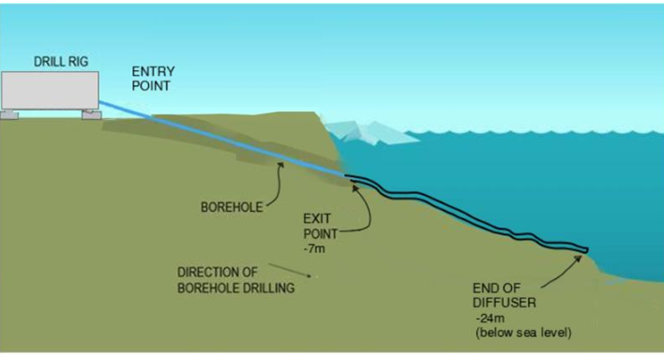
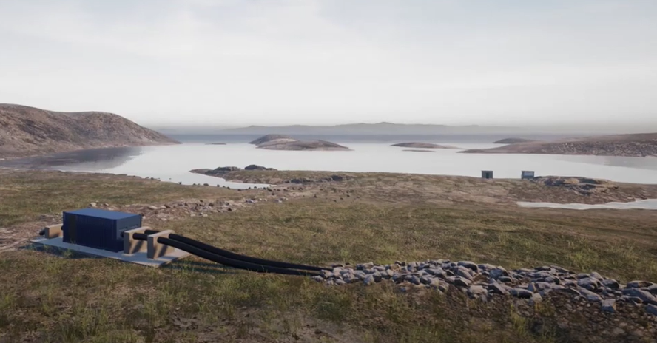
CONSTRUCTION / ᓴᓇᔪᑦ
HDD is the preferred method because:
Water discharge would not be impacted by ice erosion during this period
Will create less bed sediment disturbance and lower levels of suspended sediment
HDD was the method used in Rankin Inlet for installation of the sewage discharge line to Hudson Bay
HDD will result in less debris in the water as the material being drill is recovered as the hole is being drilled
Drilling associated with the HDD will not produce more noise that what is already occurring including air transportation, nearby industrial activities, and community resupply activities
HDD ᐊᑐᖅᑕᐅᖔᕈᒪᔪᖅ ᐃᒪᓐᓇᐃᒻᒪᑦ:
ᐃᒪᖅ ᑯᕕᑎᑕᐅᔪᖅ ᐊᒃᑐᖅᑕᐅᔾᔮᙱᒻᒪᑦ ᓯᑯᒥᑦ ᓱᕋᒃᐸᓪᓕᐊᓂᕐᒧᑦ ᑖᑉᑯᓇᓂ ᐅᑉᓗᓂᑦ
ᒥᑭᓂᖅᓴᒥᒃ ᐊᓗᐊᓄᐊᖅᑐᖃᖅᑐᓄᑦ ᐃᖢᐃᓵᕆᓂᖃᕐᓗᓂ ᐊᒻᒪᓗ ᐊᑦᑎᖕᓂᖅᓴᐅᓗᓂ ᑕᒫᓂᖅᖠᖅᑐᑦ
HDD ᐊᑐᖅᑕᐅᓚᐅᖅᑐᖅ ᑲᖏᖅᖠᓂᕐᒥᑦ ᐃᓕᔭᐅᐃᓂᐊᖅᖢᓂ ᖁᕐᕕᖕᒥᙶᖅᑐᒥᒃ ᑯᕕᓯᓂᕐᒧᑦᓱᑉᓗᓕᒃ ᑕᓯᐅᔭᐅᔭᕐᔪᐊᕐᒧᑦ.
HDD ᐃᒪᕐᒥᑦ ᐊᒃᑕᑯᖃᐅᖅᑎᑦᑎᙱᓐᓂᖅᓴᐅᓂᐊᖅᑐᖅ ᐊᑐᖅᑕᐅᔪᑦ ᐃᑰᑕᐃᓂᕐᒧᑦ ᐅᑎᖅᑎᑕᐅᖃᑦᑕᕐᓂᐊᕐᒪᑕ ᐊᖕᒪᔪᖅ ᐃᑰᑕᖅᑕᐅᑎᓪᓗᒍ.
ᐃᑰᑕᐃᓃᑦ HDD-ᒧᑦ ᐱᔪᓂᒃ ᓂᐱᖃᙱᓐᓂᖅᓴᐅᓂᐊᖅᑐᖅ ᑕᐃᒪᐅᕌᓂᒃᑐᓂᐅᖓᓂᑦ ᐃᓚᐅᑉᓗᑎᒃ ᖃᖓᑕᓲᒃᑯᑦ ᐊᒡᔭᖅᑐᐃᓃᑦ, ᖃᓂᑦᑐᒥᑦ ᐱᓕᕆᓃᑦ, ᐊᒻᒪᓗ ᓄᓇᓕᖕᒥᑦ ᐅᒥᐊᕐᔪᐊᓕᕆᓃᑦ
Notes:
At Melvin Bay, horizontal directional drilling will be used to install the pipe
This was the same method used to install the sewage discharge line in Rankin Inlet
The benefits to this method include:
Minimal disturbance to the marine bed in the intertidal zone during construction
No impact to the pipe from ice erosion during the winter season
Horizontal directional drilling will not produce more noise and dust than what is already occurring from other nearby activities
This slide will also be presented again during the marine environment topic

Slide 12
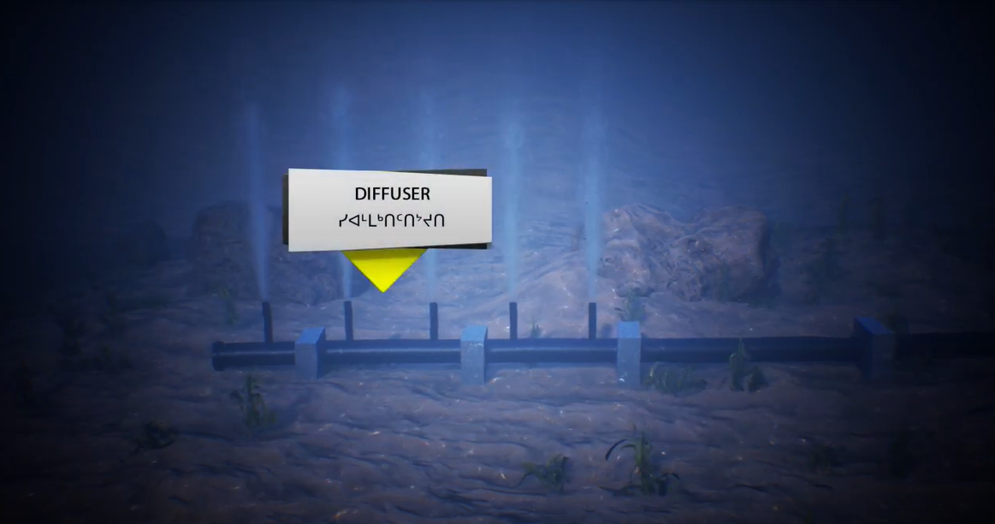
Melvin Bay DiFFuser / ᐃᑎᕕᐊᓂᑦ ᓯᐊᒻᒪᒃᑎᑦᑎᔾᔪᑎ
Notes:
This slide shows what the new diffuser could look like
This would be located in a depth of approximately 20 m (up to 24.5 m with tides)
This will be a different diffuser than the one currently used – the new diffuser will be designed to handle the higher flow rates
In addition, this in-water pipe and diffuser will not require yearly installation and removal.
The new in-water pipe and diffuser will align with the regulatory requirements identified with Fisheries and Oceans and Transport Canada
This will be discussed further in the presentation on the marine environment

Slide 13
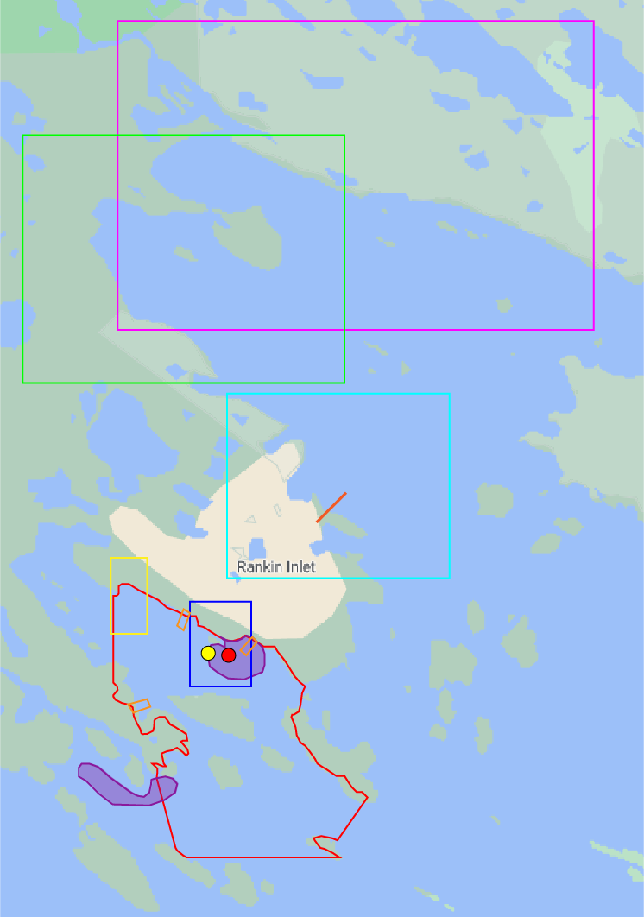
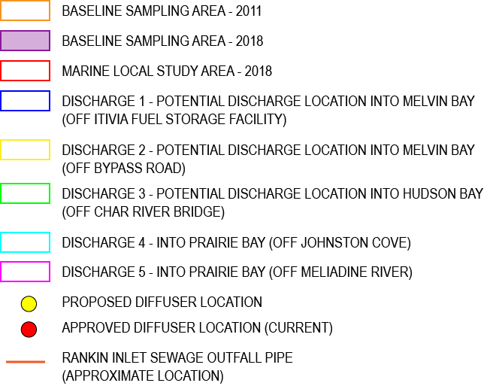
Marine Environment / ᑕᕆᐅᕐᒥᐅᑕᐃᑦ ᐊᕙᑎᖓ​
Treated groundwater will be discharged through an engineered marine outfall
Discharge volumes of 6,000 - 12,000 m³ per day, alternative up to 20,000 m³ per day
ᐱᓕᕆᐊᖑᓯᒪᔪᖅ ᐃᒪᖅ ᑯᕕᑎᑕᐅᓂᐊᖅᑐᖅ ᐱᓕᕆᐊᖑᓯᒪᔪᒃᑯᑦ ᑕᕆᐅᕐᒧᑦ ᑯᕕᑎᑕᐅᓂᒃᑯᑦ​
ᐊᖏᑎᒋᓂᖓ ᑯᕕᑎᑕᐅᔪᖅ 6,000 - 12,000 m3 ᖃᐅᑕᒫᑦ, ᐊᓯᐊᒍᒡᖓᖅ 20,000 m3 ᑎᑭᓪᓗᒍ ᖃᐅᑕᒫᑦ​
Notes:
An assessment of the potential effects to the marine environment was completed
The assessments included:
Evaluation of variable discharge rate: 6,000 to 12,000 m3/day, and up to 20,000 m3/day
Evaluation of variable discharge quality
The studies demonstrated that the dilution can be achieved within the mixing zone
The discharge will not interact with ice formation because discharge will occur during open-water conditions
This will be discussed further in the presentation on the marine environment

Slide 14
Removal and Reclamation / ᐲᖅᑕᐅᓂᖅ ᐊᒻᒪᓗ ᐅᑎᖅᑎᑎᕆᓂᖅ
Infrastructure will be dismantled and removed at the end of activities related to ocean discharge
Infrastructure will be removed consistent with the Interim Closure and Reclamation Plan
Removal of all physical hazards
ᐱᖁᑏᑦ ᐲᔭᖅᑕᐅᓂᐊᖅᑐᑦ ᓄᖅᑲᖅᐸᑕ ᑕᕆᐅᕐᒧᑦ ᑯᕕᖅᑕᐃᓃᑦ
ᐱᖁᑏᑦ ᐲᖅᑕᐅᓂᐊᖅᑐᑦ ᐊᔾᔨᖓ ᒪᓕᒡᓗᒍ ᓄᖅᑲᖓᓚᐅᐱᓪᓚᖕᓂᕐᒧᑦ ᐅᒃᑯᐊᖅᓯᓂᖅ ᐊᒻᒪᓗ ᐅᑎᖅᑎᑎᕆᓂᕐᒧᑦ ᐸᕐᓇᐅᑎ
ᐲᖅᑕᐅᓂᖏᑦ ᑕᑯᒃᓴᐅᔪᓗᒃᑖᑦ ᐅᓗᕆᐊᓇᖅᑐᓖᑦ
Notes:
Infrastructure will be dismantled and removed at the end of activities related to ocean discharge.
Infrastructure will be removed consistent with the Interim Closure and Reclamation Plan
There will be removal of all physical hazards

Slide 15
Public Participation and Engagement
ᐃᓄᓗᒃᑖᓂᒃ ᐃᓚᐅᓂᖏᑦ ᐊᒻᒪᓗ ᐃᓚᐅᑎᑦᑎᓂᖅ
15

Slide 16
Agnico Eagle’s Consultation and Engagement
ᐊᒡᓃᑯᒃᑯᑦ ᐅᖃᖃᑎᖃᖃᑦᑕᐅᑎᓂᖏᑦ ᐊᒻᒪᓗ ᐃᓚᐅᑎᑦᑎᓂᖏᑦ
Agnico Eagle's public participation and consultation approach includes collaboration with:
Impacted communities;
Inuit organizations;
Regional Inuit groups;
Elders;
Women’s group;
Hamlet Council of Rankin Inlet;
Land users; and
Other stakeholders.
In keeping with NIRB’s IQ principles of fostering transparency, inclusiveness, and collaboration, Agnico Eagle emphasized dynamic visual information and plain language dialogues led by dedicated IQ coordinator and local Agnico Eagle staff to generate input and practical recommendations by community members and local stakeholders
ᐊᒡᓃᑯᒃᑯᑦ ᐃᓄᓗᒃᑖᓂᒃ ᐃᓚᐅᑎᑦᑎᓂᐊᖅᑐᑦ ᐅᖃᖃᑎᖃᕐᓗᑎᒡᓗ ᐊᒻᒪᓗ ᐱᓕᕆᖃᑎᒋᓗᒋᑦ ᐅᑯᓂᙵᑦ:
ᐊᒃᑐᖅᑕᐅᓯᒪᔪᑦ ᓄᓇᓖᑦ;
ᐃᓄᐃᑦ ᐱᓕᕆᖃᑎᒌᖏᑦ;
ᐊᕕᒃᑐᖅᓯᒪᔪᒥᑦ ᐃᓄᐃᑦ ᑲᑐᔾᔨᖃᑎᒌᑦ;
ᐃᓐᓇᕆᔭᐅᔪᑦ;
ᐊᕐᓇᓄᑦ ᑲᑎᒪᔪᑦ;
ᕼᐋᒻᓚᒃᑯᑦ ᑲᑎᒪᔨᖏᑦ ᑲᖏᖅᖠᓂᕐᒥᑦ;
ᓄᓇᒥᒃ ᐊᑐᖃᑦᑕᖅᑐᑦ; ᐊᒻᒪᓗ
ᐊᓯᖏᑦ ᐱᖃᖃᑕᐅᔪᑦ.
ᒪᓕᒃᖢᒋᑦ ᐊᕙᑎᓕᕆᔨᒃᑯᑦ ᐃᓄᐃᑦ ᖃᐅᔨᒪᔭᑐᖃᖏᓐᓄᑦ ᐊᑐᖁᔭᖏᓐᓂᑦ ᑕᑯᒃᓴᐅᑎᑦᑎᓂᕐᒥᑦ, ᐃᓚᐅᑎᑦᑎᓗᒃᑖᕐᓂᕐᒥᑦ, ᐊᒻᒪᓗ ᐱᓕᕆᖃᑎᒌᖕᓂᕐᒥᑦ, ᐊᒡᓃᑯᒃᑯᑦ ᖃᐅᔨᒪᖁᔨᔪᑦ ᐊᔾᔨᒌᙱᑦᑐᓂᒃ ᑕᑯᒃᓴᐅᔪᓂᒃ ᑐᑭᓯᐅᒪᔾᔪᑎᓂᒃ ᐊᒻᒪᓗ ᑐᑭᓯᐊᓇᖅᑐᒃᑯᑦ ᐅᖃᐅᓯᒃᑯᑦ ᐊᑐᖅᑕᐅᔪᓂᒃ ᐃᓄᐃᑦ ᖃᐅᔨᒪᔭᑐᖃᖏᓐᓄᑦ ᑐᑭᒧᐊᒃᑎᑦᑎᔨᓄᑦ ᐱᓕᕆᐊᖑᖃᑦᑕᖅᑐᑦ ᐊᒻᒪᓗ ᐊᒡᓃᑯᒃᑯᑦ ᐱᓕᕆᔨᖏᓐᓄᑦ ᐅᖃᐅᓯᐅᔪᓂᑦ ᐃᓱᒪᒋᔭᐅᔪᓂᒃ ᐱᓗᑎᒃ ᐊᒻᒪᓗ ᐊᑐᕈᒥᓇᖅᑐᓂᑦ ᐃᒪᓐᓈᖅᑑᑕᐅᔪᓂᒃ ᓄᓇᓕᖕᒥᐅᓂᑦ ᐊᒻᒪᓗ ᓄᓇᓕᖕᒥᑦ ᐃᓚᐅᖃᑕᐅᔪᓂᑦ

Slide 17
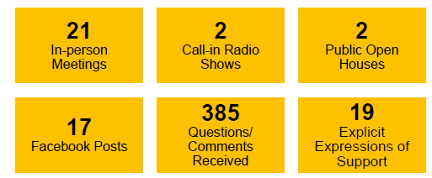
Waterline project Consultation / ᐃᒪᕐᒧᑦ ᓱᑉᓗᓕᐅᑉ ᒥᒃᓵᓄᑦ ᐱᓕᕆᐊᕐᒥᑦ ᐅᖃᖃᑎᖃᕐᓂᖅ
March 2020
Initial Consultation
ᓇᑦᑎᐊᑦ 2020
ᐅᖃᖃᑎᖃᕐᓗᓂ
July 2020
Second Round Consultations
ᓴᒡᒐᕈᑦ 2020
ᑐᒡᓕᐊᓂᑦ ᐅᖃᖃᑎᖃᕐᓗᓂ
November 2020
Targeted and Focus Group Meetings
ᑲᑕᒑᕆᕝᕕᒃ 2020
ᑐᕌᖅᑕᐅᔪᑦ ᐊᒻᒪᓗ ᑕᐅᑐᒐᖃᕐᓂᕐᒧᑦ ᑲᑎᒪᔪᑦ ᑲᑎᒪᓂᖏᑦ
February 2021
Local Community Leader Meetings (incld. Elected officials + Hunters)
ᐊᕗᓐᓂᕕᒃ 2021
ᓄᓇᓕᖕᒥᑦ ᓯᕗᓕᐅᖅᑎᓂᑦ ᑲᑎᒪᓃᑦ
(ᐃᓚᐅᑉᓗᑎᒃ ᓂᕈᐊᖅᑕᐅᓯᒪᔪᑦ ᐊᒻᒪᓗ ᒪᖃᐃᑏᑦ)
December 2020
Targeted and Focus Group Meetings
ᐋᒡᔪᓕᕐᕕᒃ 2020
ᑐᕌᖅᑕᐅᔪᑦ ᐊᒻᒪᓗ ᑕᐅᑐᒐᖃᕐᓂᕐᒧᑦ ᑲᑎᒪᔪᑦ ᑲᑎᒪᓂᖏᑦ
10 Additional Focus Groups since
August 28, 2020
Agnico Eagle | Saline Effluent Discharge – Final Hearing
Notes:
Main questions or comments received during consutlations included Constrution & Design of the waterline, community involvement + consultation, wildlife, health & Safety, and marine sediment & water quality

Slide 18
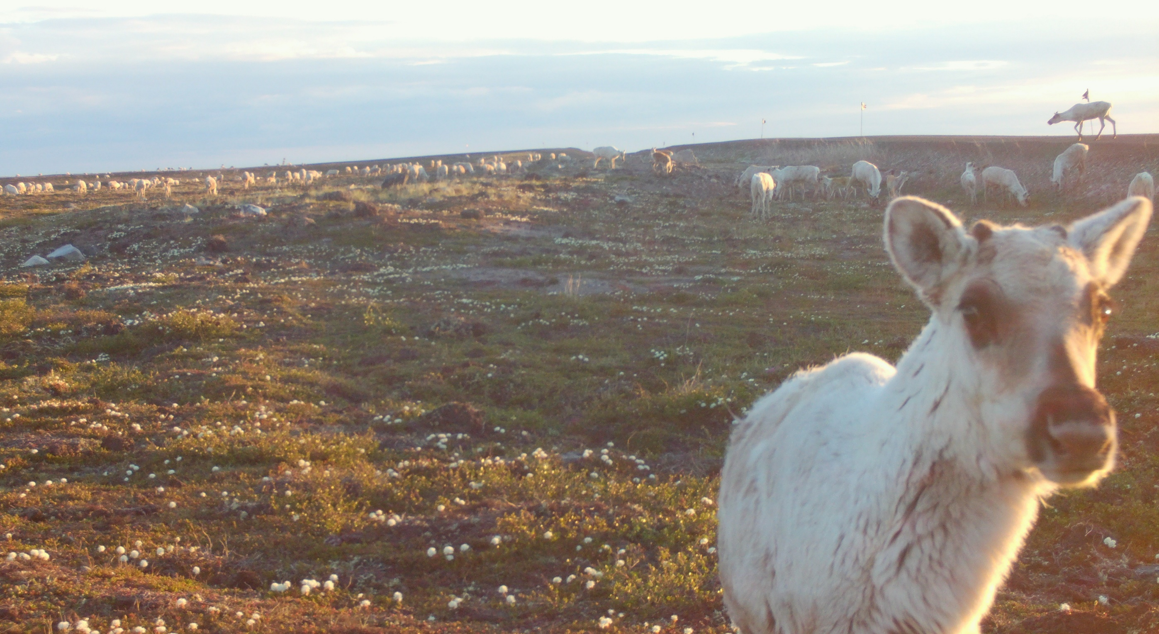
Waterline project Consultation / ᐃᒪᕐᒧᑦ ᓱᑉᓗᓕᐅᑉ ᒥᒃᓵᓄᑦ ᐱᓕᕆᐊᕐᒥᑦ ᐅᖃᖃᑎᖃᕐᓂᖅ
From the feedback received during the March 2020 consultations, Agnico Eagle discussed building crossings along the proposed waterline for caribou, ATVs, and snowmobiles
During the July 2020 consultations, we heard that some people prefer the waterline to increased trucking; however, concerns were raised regarding potential impacts to caribou migration
To address those concerns with caribou, stakeholders suggested to cover the waterline instead of crossings
ᑐᓴᕐᕕᐅᓚᐅᖅᑐᓂᑦ ᓇᑦᑎᐊᑦ-ᒥᑦ (ᒫᑦᓯ) ᐅᖃᖃᑎᖃᕐᓂᐅᔪᓂᑦ, ᐊᒡᓃᑯᒃᑯᑦ ᐅᖃᐅᓯᖃᓚᐅᖅᑐᑦ ᐃᑳᕈᑎᓕᐅᕐᓂᐊᕐᓗᑎᒃ ᓱᑉᓗᓕᒃᑯᑦ ᑐᒃᑐᓄᑦ, ᕼᐋᓐᑕᓄᑦ, ᐊᒻᒪᓗ ᓯᑭᑑᓄᑦ
ᓴᒡᒐᕈᑦ 2020-ᒥᑦ ᐅᖃᖃᑎᖃᖅᑎᓪᓗᒋᑦ, ᑐᓴᓚᐅᖅᑐᒍᑦ ᐃᓚᖏᑦ ᐃᓄᐃᑦ ᐃᒪᕐᒧᑦ ᓱᑉᓗᓕᐅᑉ ᒥᒃᓵᓄᑦ ᐊᒡᔭᖅᑐᖅᑕᐅᓂᖓ ᓄᓇᒃᑰᕈᑎᒃᑯᑦ ᐊᒥᓱᙳᕆᐊᖔᖁᔨᑉᓗᑎᒃ; ᑭᓯᐊᓂ, ᐃᓱᒫᓘᑎᖃᓚᐅᖅᑐᑦ ᐊᒃᑐᖅᓯᓂᐅᔪᖕᓇᖅᑐᓂᒃ ᑐᒃᑐᐃᑦ ᐊᒥᕐᕋᐃᑦ ᓅᖃᑦᑕᕐᓂᖏᓐᓂᑦ
ᐱᓕᕆᐊᕆᓂᐊᕐᓗᒋᑦ ᐃᓱᒫᓘᑕᐅᔪᑦ ᑐᒃᑐᓄᑦ, ᐃᓚᐅᖃᑕᐅᔪᑦ ᐅᖃᓚᐅᖅᑐᑦ ᖄᓕᕐᓗᒍ ᐃᒪᕐᒧᑦ ᓱᑉᓗᓕᒃ ᐃᑳᕐᕕᓕᐅᖏᖔᕐᓗᑎᒃ

Slide 19
Response to Final Written Submission + Commitments Made
ᑭᐅᔾᔪᑏᑦ ᑭᖑᓪᓕᖅᐹᖅ ᑎᑎᕋᖅᓯᒪᔪᑦ ᑐᓂᐅᑕᐅᔪᓄᑦ ᐊᒻᒪᓗ ᐱᓂᐊᕐᓂᕆᔭᐅᔪᓕᐊᓄᑦ
19

Slide 20
Status of Reviews / ᖃᓄᐃᖓᓂᖓᑕ ᕿᒥᕐᕈᔭᐅᓃᑦ
Item | Parties | Numbers | Resolved | Unresolved* | Comments | ᐅᖃᐅᓯᑦᓴᑦ
Final Written Submission ᑭᖑᓪᓕᖅᐹᖅ ᑎᑎᕋᖅᓯᒪᔪᖅ ᑐᓂᐅᑕᐅᔪᖅ | KivIA | 8 | 3 | 5 | Final Written Submissions includes continuation of comments from Information Request and Technical Comments | ᑭᖑᓪᓕᖅᐹᖅ ᑎᑎᕋᖅᓯᒪᔪᑦ ᑐᓂᐅᑕᐅᔪᓂᑦ ᐃᓚᐅᔪᑦ ᐅᖃᐅᓯᐅᔪᓂᒃ ᐱᖃᑦᑕᐃᓐᓇᕐᓗᑕ ᑐᑭᓯᐅᒪᔾᔪᑎᓂᒃ ᑐᒃᓯᕋᐅᑕᐅᔪᓂᑦ ᐊᒻᒪᓗ ᐱᓕᕆᐊᕐᒧᑦ ᐅᖃᐅᓯᐅᔪᓂᑦ
 | K-HTO | 1 | 1 | 0 | With the information provided, Agnico Eagle considers resolved | ᑐᑭᓯᐅᒪᔾᔪᑏᑦ ᑐᓂᔭᐅᔪᓂᑦ, ᐊᒡᓃᑯᒃᑯᑦ ᐋᖅᑭᒃᓯᓂᕋᐃᔪᑦ
 | KWB | 3 | 3 | 0 | With the information provided, Agnico Eagle considers resolved | ᑐᑭᓯᐅᒪᔾᔪᑏᑦ ᑐᓂᔭᐅᔪᓂᑦ, ᐊᒡᓃᑯᒃᑯᑦ ᐋᖅᑭᒃᓯᓂᕋᐃᔪᑦ
 | NTI | 1 | 1 | 0 | With the information provided, Agnico Eagle considers resolved | ᑐᑭᓯᐅᒪᔾᔪᑏᑦ ᑐᓂᔭᐅᔪᓂᑦ, ᐊᒡᓃᑯᒃᑯᑦ ᐋᖅᑭᒃᓯᓂᕋᐃᔪᑦ
 | CIRNAC | 10 | 10 | 0 | Final Written Submissions continuation of comments from Technical Comments | ᑭᖑᓪᓕᖅᐹᖅ ᑎᑎᕋᖅᓯᒪᔪᑦ ᑐᓂᐅᑕᐅᔪᓂᑦ ᐅᖃᐅᓯᐅᔪᓂᒃ ᐱᖃᑦᑕᐃᓐᓇᕐᓂᖅ ᐊᒻᒪᓗ ᐱᓕᕆᐊᕐᒧᑦ ᐅᖃᐅᓯᐅᔪᑦ
 | ECCC | 2 | 2 | 0
Final Written Submission | DFO | 2 | 2 | 0
 | GN | 1 | 1 | 0
 | HC | 2 | 2 | 0 | With the information provided, Agnico Eagle considers resolved | ᑐᑭᓯᐅᒪᔾᔪᑏᑦ ᑐᓂᔭᐅᔪᓂᑦ, ᐊᒡᓃᑯᒃᑯᑦ ᐋᖅᑭᒃᓯᓂᕋᐃᔪᑦ
 | NRCan | 1 | 1 | 0
 | SDFN/NDFN | 2 | 2 | 0 | With the information provided, Agnico Eagle considers resolved | ᑐᑭᓯᐅᒪᔾᔪᑏᑦ ᑐᓂᔭᐅᔪᓂᑦ, ᐊᒡᓃᑯᒃᑯᑦ ᐋᖅᑭᒃᓯᓂᕋᐃᔪᑦ
 | TC | 3 | 3 | 0
 | Total | 36 | 31 | 5
* as of May 18, 2021

Slide 21
Commitments / ᐱᓂᐊᕐᓃᑦ
Theme / ᐱᔾᔪᑕᐅᔪᖅ | Commitment Summary | ᐱᓂᐊᕐᓂᕐᒧᑦ ᓇᐃᓈᖅᓯᒪᔪᖅ
Caribou ᑐᒃᑐᐃᑦ | Form a Terrestrial Advisory Group Burry/cover between 80-90% of the waterline Collaborate with GN to evaluate remote triggered camera program No open trenches during the construction phase while caribou migrating Provide details on actual slide slopes following construction Update Terrestrial Environment Management and Monitoring Plan following meeting with Terrestrial Advisory Group | ᓄᓇᒥᐅᑕᐃᑦ ᒥᒃᓵᓄᑦ ᐅᖃᐅᔾᔨᔨᒃᑯᑦ ᓄᓇᐅᑉ ᐃᓗᐊᓄᐊᕐᓗᒍ/ᖄᓕᕐᓗᒍ 80-90%-ᖓ ᐃᒪᕐᒧᑦ ᓱᑉᓗᓕᒃ ᐱᓕᕆᖃᑎᖃᕐᓗᑎᒃ ᓄᓇᕗᑦ ᒐᕙᒪᒃᑯᓐᓂ ᖃᐅᔨᓴᕐᓂᐊᕐᓗᓂ ᐊᐅᓚᑕᐅᔪᓂᒃ ᐊᔾᔨᓕᐅᕈᑎᐅᑉ ᐱᓕᕆᐊᖓᓂᒃ ᓄᓇᒥᑦ ᐃᓗᑦᑐᖅᓯᒪᔪᖃᔾᔮᙱᑦᑐᖅ ᓴᓇᔭᐅᕙᓪᓕᐊᑎᓪᓗᒍ ᑐᒃᑐᐃᑦ ᐊᒥᕐᕋᐃᑦ ᑕᒪᐅᓈᖅᑎᓪᓗᒋᑦ ᓇᓗᓇᐃᔭᖅᓯᒪᔪᓂᒃ ᑐᓂᓯᓗᓂ ᐅᕕᖓᓂᐅᔪᑦ ᒥᒃᓵᓄᑦ ᓴᓇᔭᐅᕌᓂᒃᑎᓪᓗᒍ ᐅᑉᓗᒥᒨᓕᖅᑐᕐᓗᒍ ᓄᓇᒥᐅᑕᓂᒃ ᐊᐅᓚᑦᑎᓂᖅ ᐊᒻᒪᓗ ᖃᐅᔨᓴᐃᓂᕐᒧᑦ ᐸᕐᓇᐅᑎ ᑲᑎᒪᖃᑎᒋᖅᑳᕐᓗᒋᑦ ᓄᓇᒥᐅᑕᐃᑦ ᒥᒃᓵᓄᑦ ᐅᖃᐅᔾᔨᔨᒃᑯᑦ
Marine Environment ᑕᕆᐅᕐᒥᐅᑕᐃᑦ ᐊᕙᑎᖓ​ | Include shellfish monitoring as part of Community-based Monitoring Conduct validation monitoring post discharge during the first 3 years of the waterline operation | ᐃᓚᐅᓗᒋᑦ ᐅᕕᓗᕋᓗᖕᓂᑦ ᖃᐅᔨᓴᐃᓂᖅ ᐃᓚᒋᔭᐅᓗᓂ ᓄᓇᓕᖕᒥᑦ ᖃᐅᔨᓴᐃᓂᕐᒧᑦ ᓇᓗᓇᐃᔭᐃᓂᕐᒧᑦ ᖃᐅᔨᓴᐃᓗᓂ ᑯᕕᑎᑦᑎᓂᖄᓂᒃᑎᓪᓗᒍ ᓯᕗᓪᓕᖅᐹᑦ ᐱᖓᓱᑦ ᐅᑭᐅᓂᑦ ᐃᒪᕐᒧᑦ ᓱᑉᓗᓕᒃ ᐊᐅᓛᓕᖅᑎᓪᓗᒍ
Traditional Land Use ᐱᖅᑯᓯᒃᑯᑦ ᓄᓇᒥᒃ ᐊᑐᖃᑦᑕᕐᓂᖅ ᐊᒻᒪᓗ ᐱᕝᕕᐅᖃᑦᑕᖅᑐᓂᒃ | Review the traditional land use crossings on maps (regarding the location and size of motorized crossings), on an annual basis and using IQ – Traditional Knowledge Route waterline on the east side of the rock outcrop in the area of Apache Pass Place markers on the waterline for winter ID | ᕿᒥᕐᕈᓗᒍ ᐱᖅᑯᓯᑐᖃᕆᔭᐅᔪᖅ ᐊᑐᖅᑕᐅᓂᖓ ᓄᓇᒥᒃ ᐃᑳᕐᕖᑦ ᓄᓇᙳᐊᓃᑦᑐᑦ (ᐱᔾᔪᑎᖃᖅᑐᑦ ᐃᓂᐅᔪᒥᑦ ᐊᒻᒪᓗ ᐊᖏᓂᖏᑦ ᐃᑯᒪᓅᖅᑐᑦ ᐃᑳᕐᕖᑦ), ᐊᕐᕌᒍᑕᒫᒃᑯᑦ ᐊᒻᒪᓗ ᐊᑐᕐᓗᒍ ᐃᓄᐃᑦ ᖃᐅᔨᒪᔭᑐᖃᖏᑦ - ᐱᖅᑯᓯᒃᑯᑦ ᖃᐅᔨᒪᓂᕆᔭᐅᔪᑦ ᐃᒪᕐᒧᑦ ᓱᑉᓗᓕᒃ ᑲᓇᖕᓇᖓᒎᖅᑎᓪᓗᒍ ᐅᔭᕋᖃᐅᕐᓂᐅᑉ ᖃᓂᑕᖓᓂᑦ ᐊᐹᑦᓯ ᐹᔅ (Apache Pass) ᐅᑭᐅᒃᑯᑦ ᓇᓗᓇᐃᒃᑯᑦᑎᖅᓯᓗᓂ ᐃᒪᕐᒧᑦ ᓱᑉᓗᓕᖕᒥᑦ
Waterline Operations ᓱᑉᓗᓕᒃ ᐊᑐᖅᑕᐅᓂᖓ | Test the waterline prior to each discharge season Long-term monitoring study that will inform adaptive management Update Management Plans to include the operation of the waterline Install a leak detection system Provide a toll-free number to report problems | ᐆᒃᑐᕋᕐᓗᒍ ᐃᒪᕐᒧᑦ ᓱᑉᓗᓕᒃ ᑯᕕᑎᑦᑎᓂᐊᓵᖅᑎᓪᓗᒋᑦ ᐊᑯᓂᐅᔪᒥᑦ ᖃᐅᔨᓴᐃᓂᕐᒧᑦ ᖃᐅᔨᓴᐃᓂᖃᕐᓗᓂ ᐃᑲᔪᕐᓂᐊᖅᑐᖅ ᐊᑐᓕᖅᑎᑦᑎᓂᕐᒧᑦ ᐊᐅᓚᑦᑎᓂᕐᒥᑦ ᐅᑉᓗᒥᒨᓕᖅᑐᕐᓗᒋᑦ ᐊᐅᓚᑦᑎᓂᕐᒧᑦ ᐸᕐᓇᐅᑏᑦ ᐃᓚᐅᑎᓐᓂᐊᕐᓗᒍ ᐊᐅᓛᖅᑎᑕᐅᓂᖓ ᐃᒪᕐᒧᑦ ᓱᑉᓗᓕᒃ ᐃᓕᓯᓗᓂ ᑯᕕᔪᖃᓕᖅᐸᑦ ᖃᐅᔨᔾᔪᑎᒥᑦ ᐊᑭᖃᙱᑦᑐᒥᑦ ᐅᖃᓘᑎᖃᖅᑎᑦᑎᓗᓂ ᓈᒻᒪᙱᑦᑐᓂᒃ ᖃᐅᔨᔭᐅᔪᖃᖅᐸᑦ ᐅᖃᐅᓯᕆᔪᖕᓇᕐᓂᐊᕐᓗᒋᑦ

Slide 22
Ma’tna; Thank You; ᖁᔭᓐᓇᒦᒃ

